Slide 1
Uva 109
SCUD Busters
Time: 3 seconds

Slide 2
Problem Descriptions
Some problems are difficult to solve but have a simplification that is easy to solve. Rather than deal with the difficulties of constructing a model of the Earth (a somewhat oblate spheroid), consider a pre-Columbian flat world that is a 500 kilometer 500 kilometer square.

Slide 3
Problem Descriptions
In the model used in this problem, the flat world consists of several warring kingdoms. Though warlike, the people of the world are strict isolationists; each kingdom is surrounded by a high (but thin) wall designed to both protect the kingdom and to isolate it. To avoid fights for power, each kingdom has its own electric power plant.

Slide 4
Problem Descriptions
When the urge to fight becomes too great, the people of a kingdom often launch missiles at other kingdoms. Each SCUD missile (Sanitary Cleansing Universal Destroyer) that lands within the walls of a kingdom destroys that kingdom's power plant (without loss of life).

Slide 5
Problem Descriptions
Given coordinate locations of several kingdoms (by specifying the locations of houses and the location of the power plant in a kingdom) and missile landings you are to write a program that determines the total area of all kingdoms that are without power after an exchange of missile fire.

Slide 6
Problem Descriptions
In the simple world of this problem kingdoms do not overlap. Furthermore, the walls surrounding each kingdom are considered to be of zero thickness. The wall surrounding a kingdom is the minimal-perimeter wall that completely surrounds all the houses and the power station that comprise a kingdom; the area of a kingdom is the area enclosed by the minimal-perimeter thin wall.

Slide 7
Problem Descriptions
There is exactly one power station per kingdom.
There may be empty space between kingdoms.

Slide 8
Input (1/3)
The input is a sequence of kingdom specifications followed by a sequence of missile landing locations.
A kingdom is specified by a number N (3≦ N≦100) on a single line which indicates the number of sites in this kingdom.
The next line contains the x and y coordinates of the power station, followed by N-1 lines of x, y pairs indicating the locations of homes served by this power station.

Slide 9
Input (2/3)
A value of -1 for N indicates that there are no more kingdoms. There will be at least one kingdom in the data set.
Following the last kingdom specification will be the coordinates of one or more missile attacks, indicating the location of a missile landing. Each missile location is on a line by itself. You are to process missile attacks until you reach the end of the file.

Slide 10
Input (3/3)
Locations are specified in kilometers using coordinates on a 500 km by 500 km grid. All coordinates will be integers between 0 and 500 inclusive. Coordinates are specified as a pair of integers separated by white-space on a single line. The input file will consist of up to 20 kingdoms, followed by any number of missile attacks.

Slide 11
Output
The output consists of a single number representing the total area of all kingdoms without electricity after all missile attacks have been processed.
The number should be printed with (and correct to) two decimal places.

Slide 12

Sample Input / Output
12
3 3
4 6
4 11
4 8
10 6
5 7
6 6
6 3
7 9
10 4
10 9
1 7
5
20 20
20 40
40 20
40 40
30 30
3
10 10
21 10
21 13
-1
5 5
20 12
70.50
kingdom1
kingdom2
kingdom3
missile attacks

Slide 13

missile
(21,13)
(4,11)
(10,10)
(1,7)
(21,10)
(10,9)
(10,4)
(3,3)
(6,3)

Slide 14
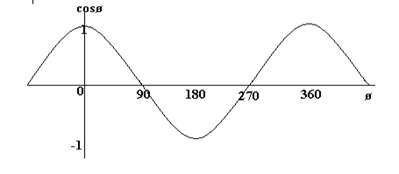



Inner Product
$$\overset{⃑}{V_{1}}∙\overset{⃑}{V_{2}}=|\overset{⃑}{V_{1}}||\overset{⃑}{V_{2}}|\cos{θ}$$
$\cos{θ}=\frac{\overset{⃑}{V_{1}}∙\overset{⃑}{V_{2}}}{|\overset{⃑}{V_{1}}||\overset{⃑}{V_{2}}|}$
$$\overset{⃑}{V_{1}}=(x_{1},y_{1})$$
$$\overset{⃑}{V_{2}}=(x_{2},y_{2})$$
$$\cos{θ}=\frac{x_{1}x_{2}+y_{1}y_{2}}{\sqrt[2]{x_{1}^{2}+y_{1}^{2}} \sqrt[2]{x_{2}^{2}+y_{2}^{2}}}$$

Slide 15
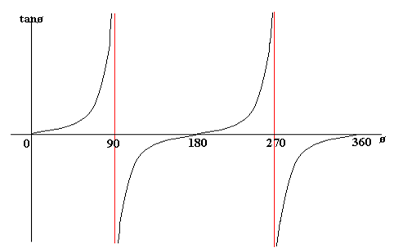
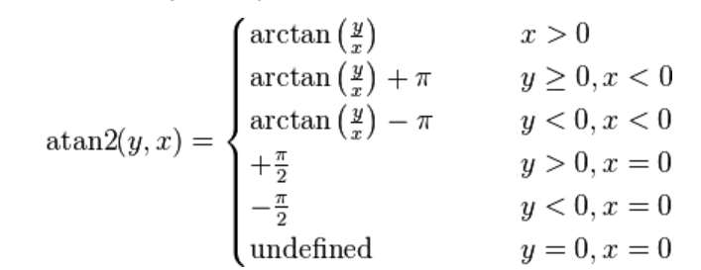

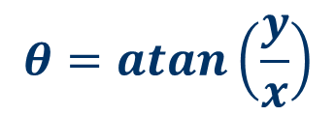
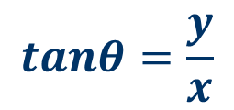
atan( )
(x,y)
$$tanθ=\frac{y}{x}$$
But, x=0?
y
$$θ=atan\left(\frac{y}{x}\right)$$
$$θ$$
(0,0)
x

Slide 16

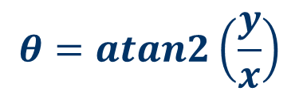


atan2( )
(x<0,y>0)
$$θ2$$
(x>0,y>0)
(x,y)
$$θ=atan2\left(\frac{y}{x}\right)$$
$$θ3$$
y
$θ$1
x

Slide 17
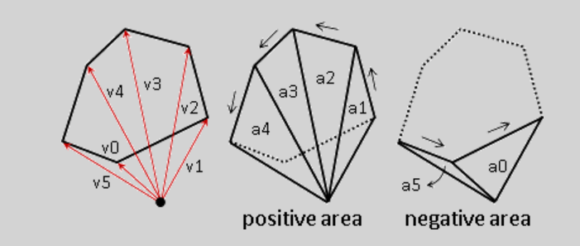
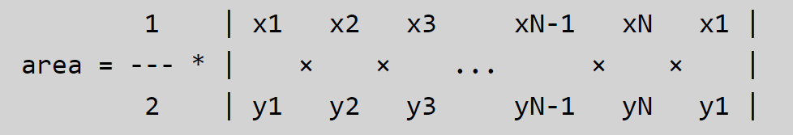
Area of polygon
(0,0)
_
+

Slide 18
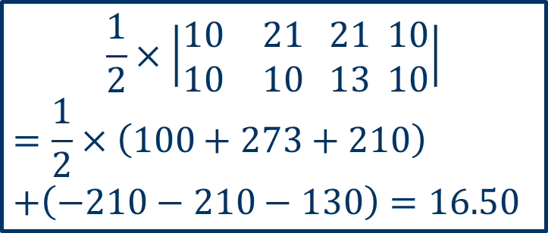
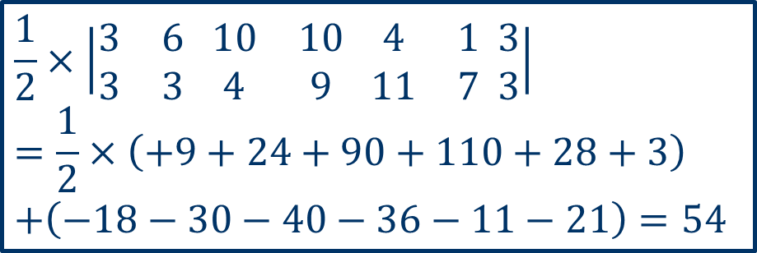

Area of Polygon
(4,11)
(1,7)
(21,13)
(10,9)
(10,10)
(10,4)
(3,3)
(6,3)
(21,10)
$$\frac{1}{2}×\left|\begin{matrix}3 & 6 \\ 3 & 3\end{matrix} \begin{matrix}10 & 10 \\ 4 & 9\end{matrix} \begin{matrix}4 & 1 \\ 11 & 7\end{matrix} \begin{matrix}3 \\ 3\end{matrix}\right|$$
$$=\frac{1}{2}×\left(+9+24+90+110+28+3\right)$$
$$+\left(−18−30−40−36−11−21\right)=54$$
$$\frac{1}{2}×\left|\begin{matrix}10 & 21 \\ 10 & 10\end{matrix} \begin{matrix}21 \\ 13\end{matrix} \begin{matrix}10 \\ 10\end{matrix}\right|$$
$$=\frac{1}{2}×\left(100+273+210\right)$$
$$+\left(−210−210−130\right)=16.50$$
$$54+16.50=70.50$$

Slide 19
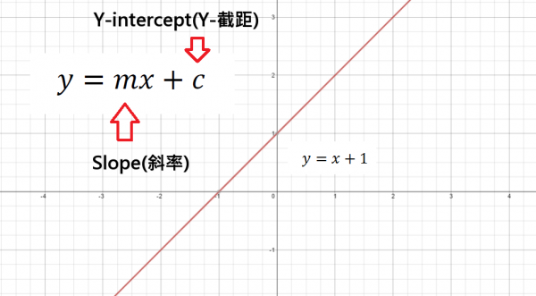
Slope-Intercept Formula
y-x-1=0
(2,0)→0-2-1<0
(3,1)→1-3-1<0
(-2,0)→0+2-1>0
(-4,3)→3+4+1>0

Slide 20
Inside a Polygon ?

Slide 21




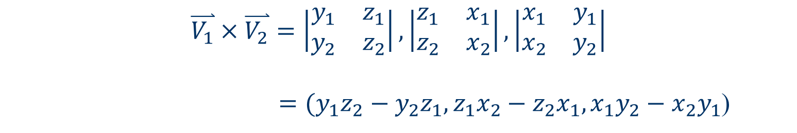

Cross Product
$$\overset{⃑}{V_{1}}=(x_{1},y_{1},z_{1})$$
$$\overset{⃑}{V_{2}}=(x_{2},y_{2},z_{2})$$
$$\overset{⃑}{V_{1}}×\overset{⃑}{V_{2}}=\left|\begin{matrix}y_{1} & z_{1} \\ y_{2} & z_{2}\end{matrix}\right|,\left|\begin{matrix}z_{1} & x_{1} \\ z_{2} & x_{2}\end{matrix}\right|,\left|\begin{matrix}x_{1} & y_{1} \\ x_{2} & y_{2}\end{matrix}\right|$$
$=(y_{1}z_{2}−y_{2}z_{1},z_{1}x_{2}−z_{2}x_{1},x_{1}y_{2}−x_{2}y_{1}$)
$$\overset{⃑}{V_{1}}=(x_{1},y_{1},0)$$
$$\overset{⃑}{V_{2}}=(x_{2},y_{2},0)$$
$$\overset{⃑}{V_{1}}×\overset{⃑}{V_{2}}=\left|\begin{matrix}y_{1} & 0 \\ y_{2} & 0\end{matrix}\right|,\left|\begin{matrix}0 & x_{1} \\ 0 & x_{2}\end{matrix}\right|,\left|\begin{matrix}x_{1} & y_{1} \\ x_{2} & y_{2}\end{matrix}\right|$$
$=(0,0,x_{1}y_{2}−x_{2}y_{1}$)

Slide 22
Graham Scan Algorithm
Find the point P[0] with the lowest y-coordinate and lowest x-coordinate.
Sort the points according to the value of cross product.
Use a stack to find the convex hull according to the scan algorithm.

Slide 23
Example
(3,4.5)
(6,2.1)
(1,1)
(3.1,1.3)
(0,0)

Slide 24
Example
(3,4.5)
3
(6,2.1)
(1,1)
(3.1,1.3)
1
4
2
(0,0)
5
(2,-3.2)

Slide 25
Example
3
1
4
2
5
(2,-3.2)
1
stack

Slide 26
Example
3
+
1
4
2
5
(2,-3.2)
2
1
stack

Slide 27
Example
3
-
1
4
2
5
(2,-3.2)
2
1
stack

Slide 28
Example
3
+
1
4
2
5
(2,-3.2)
4
3
1
stack

Slide 29
Example
3
+
1
4
2
5
(2,-3.2)
4
3
1
stack

Slide 30
Example
3
+
1
4
2
5
(2,-3.2)
5
3
1
stack

Slide 31
Tricky – Collinear
4
5
3
1
6
2
7

Slide 32
Convex Hull
Divide and Conquer-Quick Hull
Step1: QH partitions the set S of n points into two subsets and each result will be in a polygonal chain.
These two chains concatenations yields the convex hull polygon.
The initial partitioning is defined by the line passing through the points with the smallest and largest X abscissa.

Slide 33
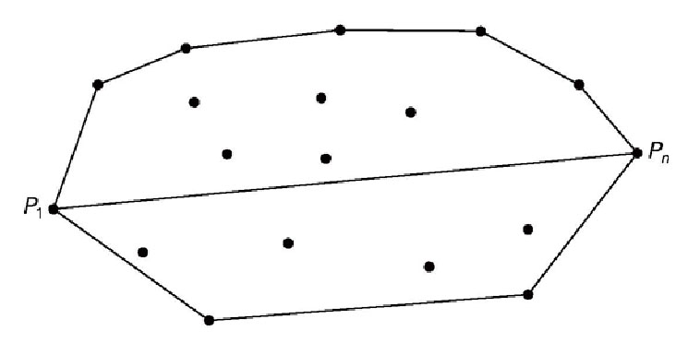
Convex Hull
Divide and Conquer-Quick Hull
Upper Hull
S₁
S₂
Lower Hull
points with the smallest and largest X abscissa

Slide 34
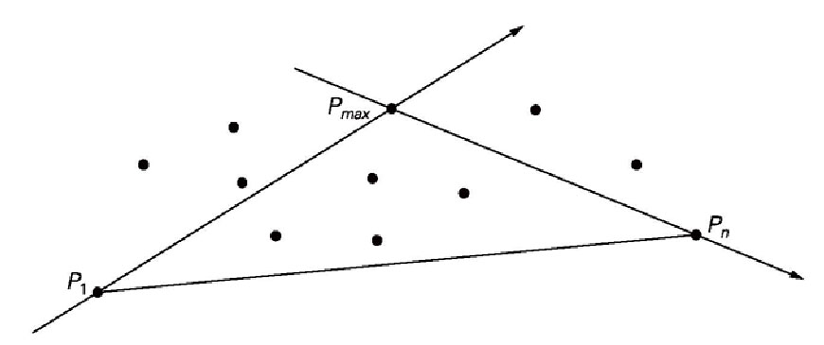
Convex Hull
Divide and Conquer-Quick Hull
Step2: In each partition hull, QH finds a P_{max} such that the area of ΔP₁P₂P_{max} is maximum.
Largest

Slide 35
Convex Hull
Divide and Conquer-Quick Hull
P_{max}
P₂
P₁

Slide 36
Convex Hull
Divide and Conquer-Quick Hull
P₂
P_{max}
P₁

Slide 37
Convex Hull
Divide and Conquer-Quick Hull
P_{max}
P₁
P₂

Slide 38
Quick Hull-Complexity
Solving Convex Hull by divide and conquer
(1) Find points with the smallest and largest X abscissa: O(n)
(2) Find the maximum area: O(n)
(3)Combine polygon : O(1)
(4)T(n)=2T(n/2)+O(n) : O(nlogn)
(5)O(n)+O(nlogn)
O(nlogn)

